Slide 1
Project 4 - Credit Risk
Justin Blake
Ryan Denninger
Neil Langer

Slide 2

Overview
Final project, combine machine learning with technologies learned throughout class.
Our project is from the viewpoint of the lending organization, to determine a client’s credit worthiness.

Slide 3
Technologies
Modules
1
Scikit learn
6
Flask
1
Python script
2
StandardScaler
TensorFlow machine learning
7
2
Java Script
OneHotEncoder
3
8
Joblib
3
HTML
4
SQLite
SQLAlchemy
9
5
Train_test_split

Slide 4
Process
Define project and scope
Load data
Clean data
StandardScaler
OneHotEncoder
Set-up SQLite data frame
train_test_split
Code the Flask app
TensorFlow Model
Define
Train
Evaluate
Optimize
Save
Load to Flask
Joblib
JavaScript coding
Pass UI input through model
SQLAlchemy to search database
HTML development
Debugging
Deployment
4

Slide 5
Data Source and Disclaimer
Data sourced from:
Kaggle - a data science competition platform and online community of data scientists and machine learning practitioners under Google LLC
https://www.kaggle.com/datasets/laotse/credit-risk-dataset/data
Disclaimer:
Results are expected to be 92% accurate based on the current model. Further considerations should be taken when assessing the credit worthiness of a person.

Slide 6
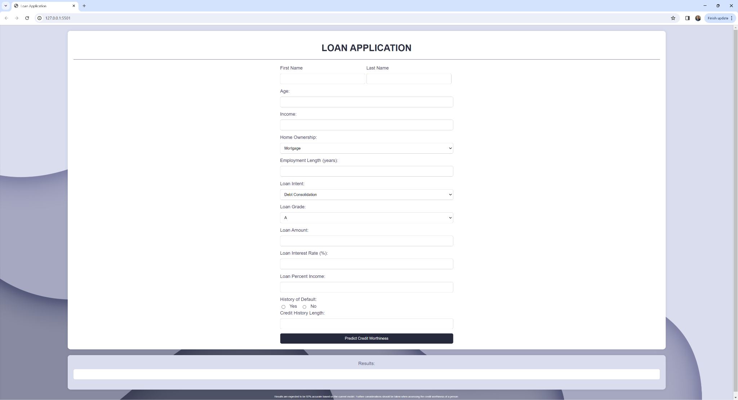
User Interface:

Slide 7
Questions?
Thank you!

